Slide 1

PARAFAC workshop Spring 2011
Monday Morning:
Introduction to DOM and Fluorescence
Lunch
Monday Afternoon:
Hands-on in the Lab
Tuesday:
PARAFAC Tutorial

Slide 2
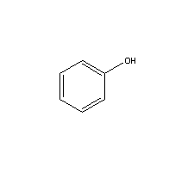
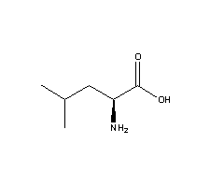
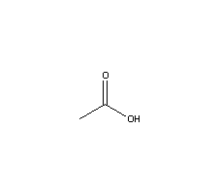
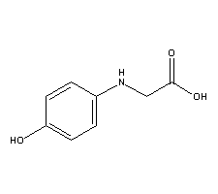
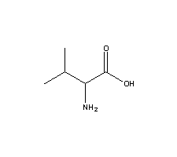
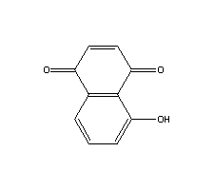
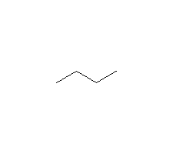
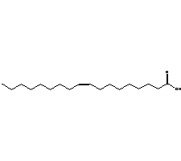
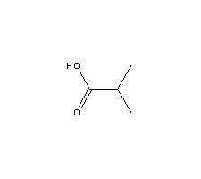
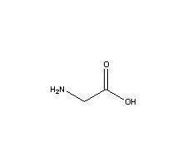
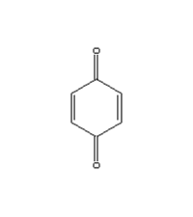
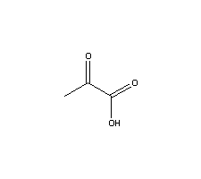
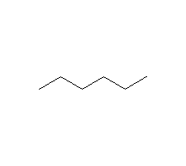
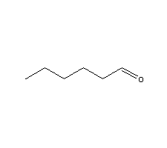
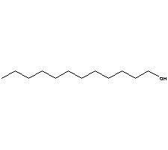
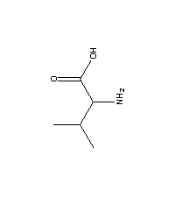
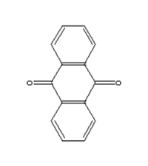
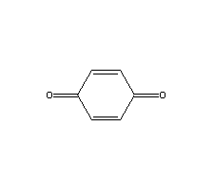
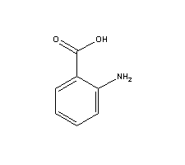
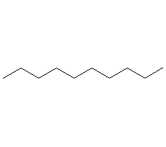
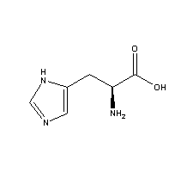
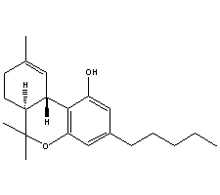
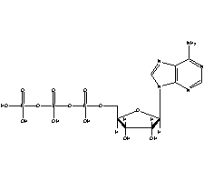
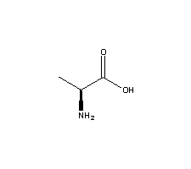
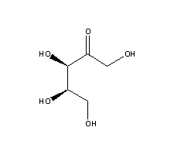
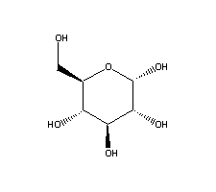
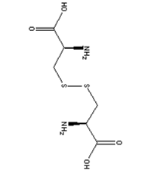
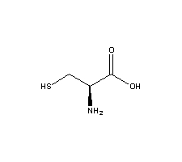
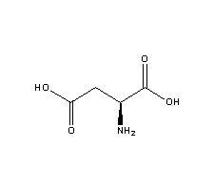
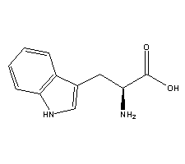
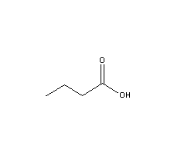
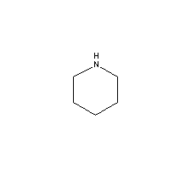
Dissolved
Organic
Matter
l
i
g
n
i
n
l
i
g
n
i
n
O
H
l
i
g
n
i
n
O
H
l
i
g
n
i
n
O
O
M
e
O
O
H
O
M
e
O
O
H
O
O
M
e
O
M
e
O
H
O
O
M
e
Slides and figures from Mark Williams, Diane McKnight, Bailey Simone, Rose Cory, Matt Miller, Rachel Gabor, Eran Hood

Slide 3
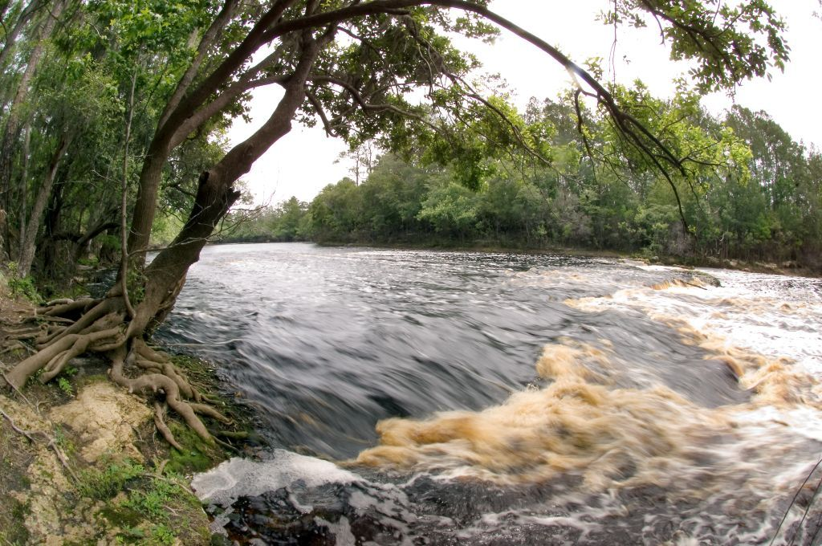
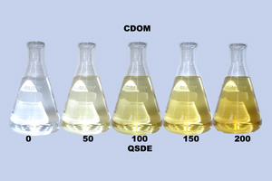
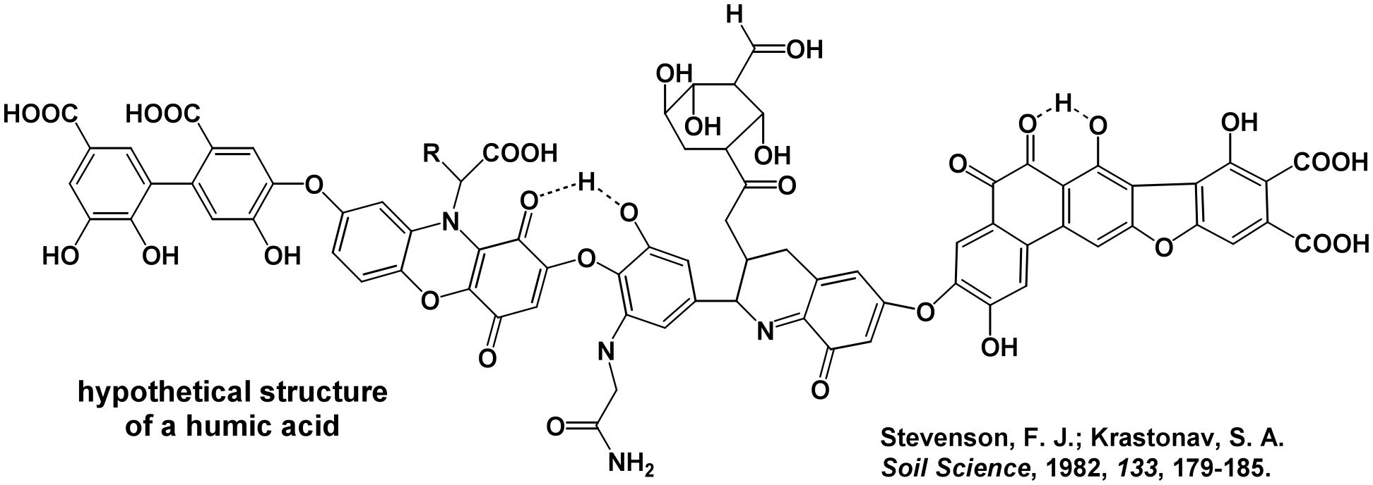
Complex, heterogeneous mixture
Truly ubiquitous (ALL waters)
Colored (gives water its color)
Moderate molecular weight
Mass Distribution:
50% C
35-40% O
4-6% H
1-6% N
<1-3%S

Slide 4
Why DOM Matters
Light absorbing DOM can act as sunscreen and control depth of photic zone
Some DOM is bio-available and contains nutrients
Organic acid portion of DOM can buffer pH
Some DOM can act as metal complexing agents (fate & transport and bioavailability of metals)
Some DOM can act as electron acceptors and donors
Reducer and oxidizer
Some DOM can “sensitize” the photochemical breakdown of pollutants
Reactions with some DOM can produce toxic disinfection byproducts during drinking water treatment

Slide 5
Dissolved Organic Matter
Neutrals
HMW Acids
LMW Acids
Bases
Autochthonous
Aquatic Input
Humic
Acids
Allochthonous
Terrestrial Input
Anthropogenic
Input
Plant
DOM
Microbial
DOM
Notes:
Already discussed role of DOM in aquatic environment
Fulvic acid is often dominant fraction, provides most of color and reactivity
Transition into using chemistry to study complex mixture

Slide 6
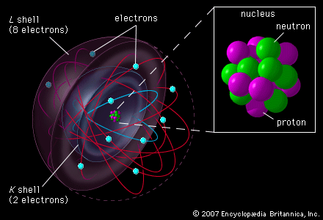
Chemistry is all about electrons

Slide 7
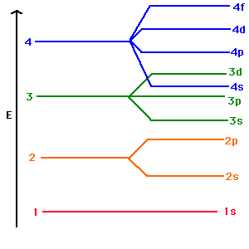
Electrons have discrete energy levels
(characteristic of the substance)

Slide 8
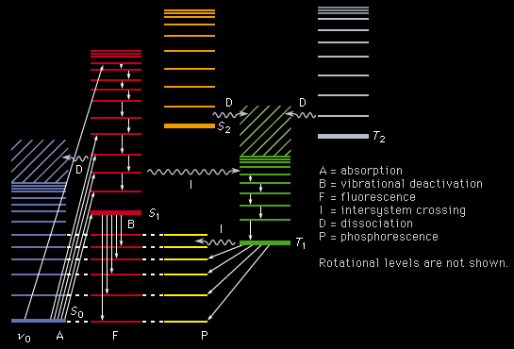
Electrons can move between energy levels

Slide 9
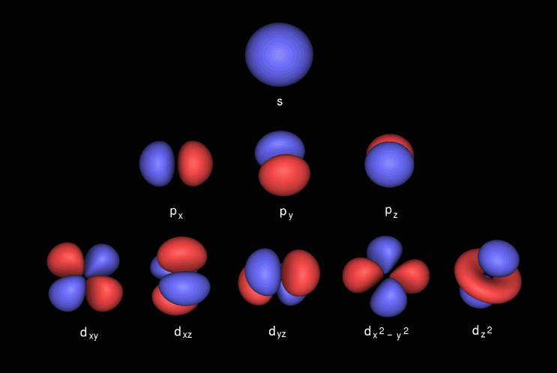
Electrons Orbitals have Specific Shapes

Slide 10
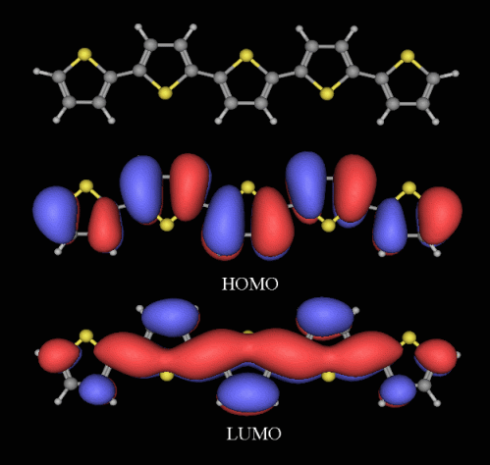
Molecules can have conjugated bonds
(Molecular Orbital Theory!)

Slide 11
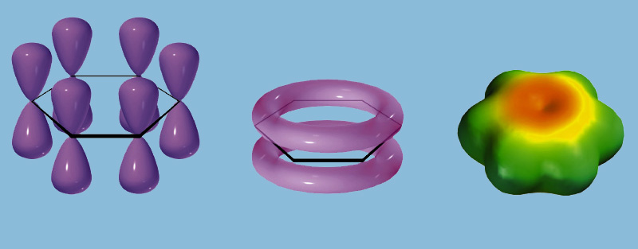
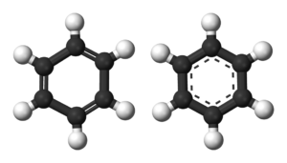
Molecules can be aromatic

Slide 12
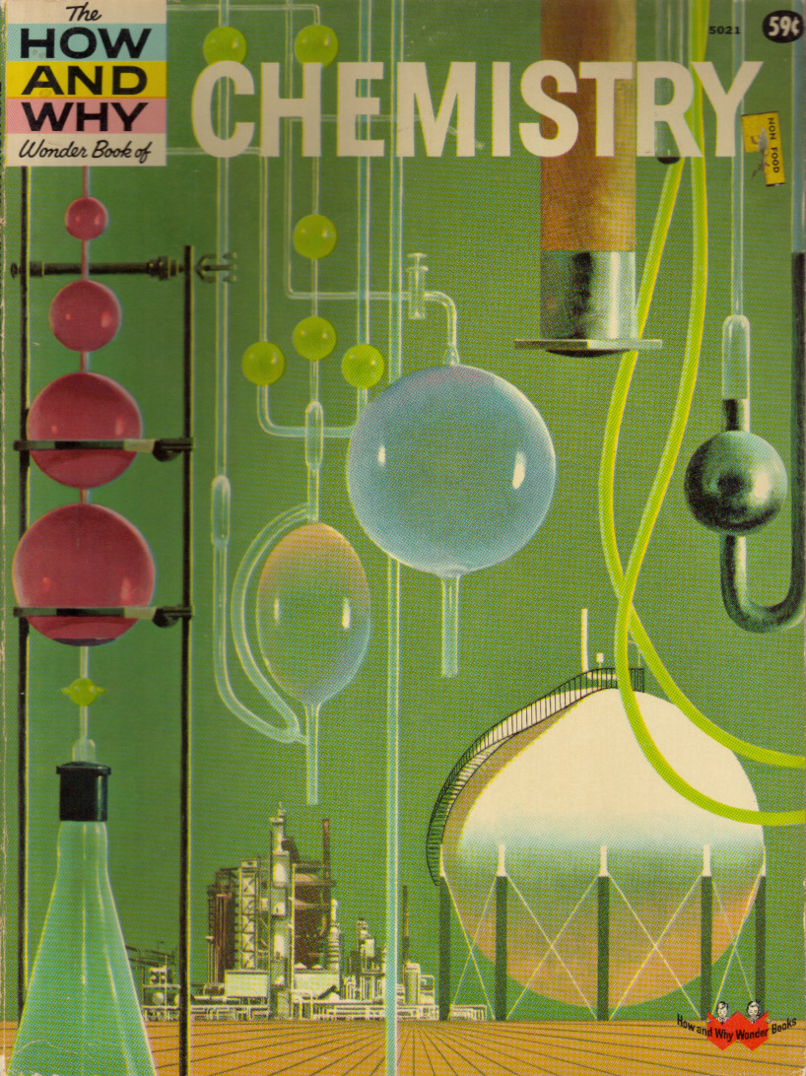
So how does this awesome chemistry help us?
Spectroscopy!
Interaction of light and matter
Specifically….
UV-VIS
Fluorescence

Slide 13
Grab your sample
Filter your sample
Run it on a DOC analyzer for Dissolved Organic Carbon (DOC) and Dissolved Organic Nitrogen (DON) concentrations
Spectroscopy!

Slide 14

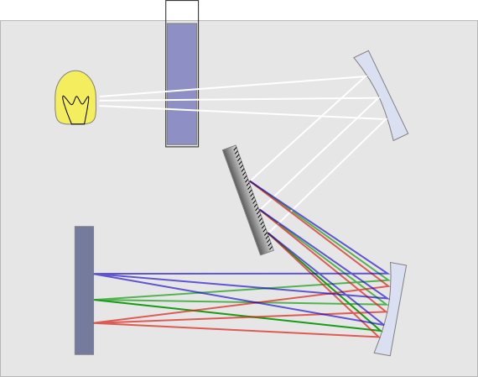
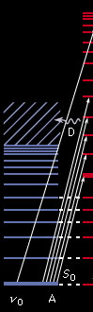
UV-VIS Spectroscopy and SUVA₂₅₄

Slide 15
UV-VIS Spectroscopy and SUVA₂₅₄
Absorbance Spectra of a DOM sample
SUVA₂₅₄ is the absorbance at 254 nm normalized to the DOC concentration

Slide 16
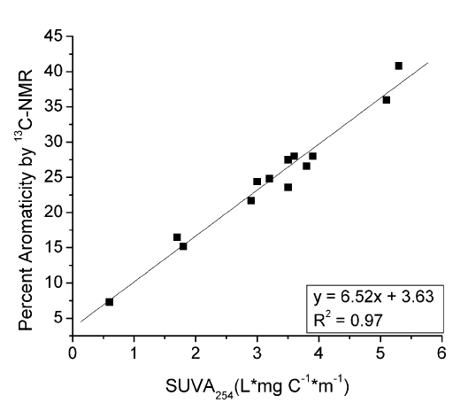
UV-VIS Spectroscopy and SUVA₂₅₄
Higher SUVA₂₅₄ means greater degree of aromaticity!

Slide 17
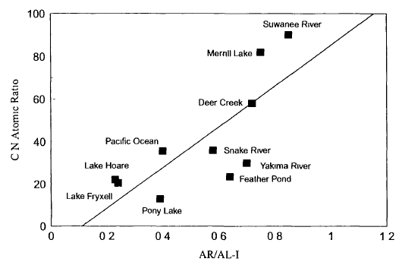
Some DOM is Yummier to Microbes
Higher C:N is more recalcitrant and more aromatic

Slide 18
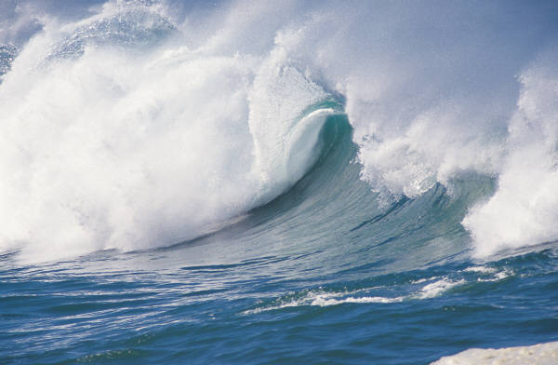
Fluorescence Spectroscopy
vibrational relaxation
S₂
Internal conversion
S₁
Geometry Rearrangements..Requires E!!
Absorbance
ΔE = λ
Fluorescence ΔE ≠ λ
ΔE = Emission λ – Excitation λ = Stokes Shift
S₀

Slide 19
Fluorescence Spectroscopy

Slide 20
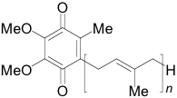
Brief
Interlude
For
More
Chemistry
“Q”
“HQ”
Quinones found in enzymes, e.g ubiquinone, and formed by lignin oxidation.
Forms of this complex are found throughout cells
Important in electron transfer reactions, such as the oxidation of NADH
Also known as coenzyme Q
Ubiquinone

Slide 21
l
i
g
n
i
n
l
i
g
n
i
n
O
H
l
i
g
n
i
n
O
H
l
i
g
n
i
n
O
O
M
e
O
O
H
O
M
e
O
O
H
O
O
M
e
O
M
e
O
H
O
O
M
e
Quinones!

Slide 22
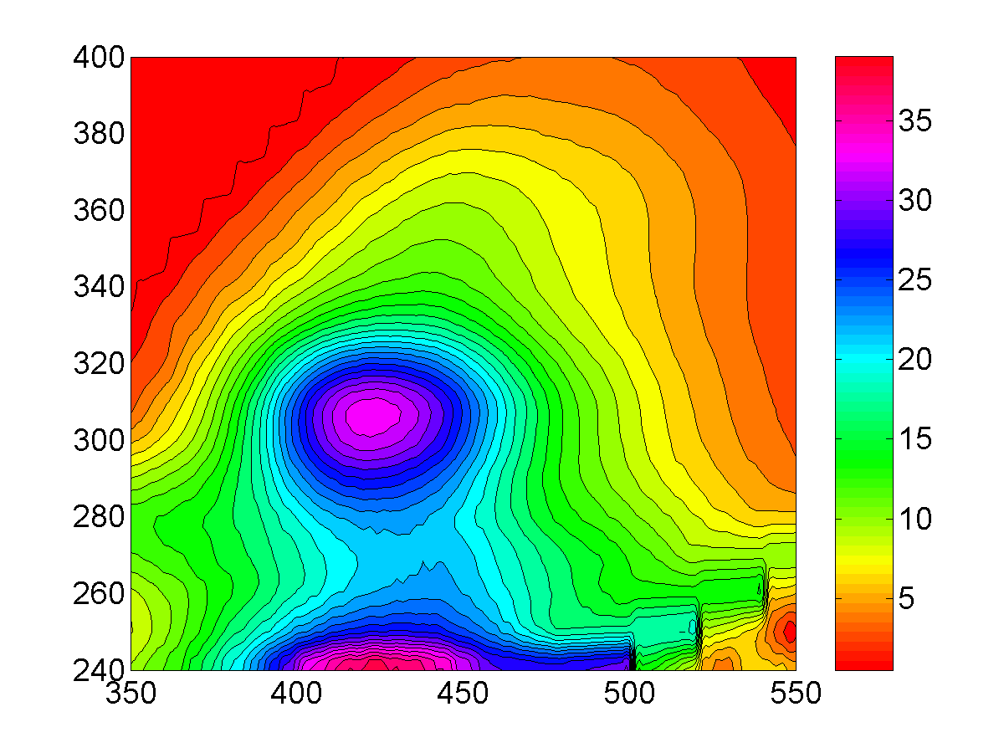
What does a DOM Fluorescence Spectrum Look Like?
humic
Excitation (nm)
Protein-like
Emission (nm)
Despite chemical diversity of DOM, similar steady state fluorescence spectra observed for ALL DOM EEMs; this strongly implies common pool of fluorophores
Notes:
Transition into there being a lot of info and ways to pull out - FI

Slide 23

Emission spectra (λ_{excit} = 370 nm) varies with source of fulvic acid

Slide 24
Fluorescence Index
Excitation (nm)
Emission (nm)
Ratio of emission intensity (470 nm / 520 nm) at 370 nm excitation

Slide 25


Fluorescence Index
Higher number = more microbial input
Lower number = more terrestrial (plant) input
FI

Slide 26

Spectroscopic Analyses
Fluorescence Index (FI)
Indicates if precursor material is more terrestrial (1.2) or more microbial (1.9).
em470/em520 at ex370
Freshness Index (β:α)
Indicates contribution of recently produced DOM where β is recently derived DOM and α is more decomposed. Larger number is newer material.
ex 310
em380/max(em420-435)
Humification Index (HIX)
How humified is the OM? Higher # indicates increasing degree of humification.
ex 254
area under em435-480/area under em300-345

Slide 27
Fluorescence - PARAFAC
Stedmon et al. 2003
Excitation-emission matrix
(EEM)
Comp. 1 Comp. 2 Comp. 3
Part 2: Fluorescence Spectroscopy

Slide 28












Cory-McKnight PARAFAC Components
Oxidized Quinone-Like Components
Reduced Quinone-Like Components
SQ1
Amino Acid-Like Components
Unknown
Components
Notes:
Cory-McKnight PARAFAC model collected hundreds of samples from biogeochemically representative ecosystems all over the world to try to create a global PARAFAC model
IT can be really good for how you fit globally, but does not always work as well with specialized samples

Slide 29
Spectroscopic Analyses
PARAFAC component ratio
What are the component fluorophores?
Excitation (nm)
Redox Index (RI)
Are the quinone-like groups more oxidized (0) or more reduced(1)? Ratio of sum of reduced quinone-like components to sum of all quinone-like components.
Emission (nm)
Protein %
What percentage of the PARAFAC components are tryptophan-like and tyrosine-like?
Notes:
Cory-McKnight PARAFAC model collected hundreds of samples from biogeochemically representative ecosystems all over the world to try to create a global PARAFAC model
IT can be really good for how you fit globally, but does not always work as well with specialized samples

Slide 30
Sample Processing - Analysis
UV-VIS Absorbance Scan
3-D Fluorescence Scan
Fluorescence Indices
PARAFAC Components
+
Modeled in Cory + McKnight Parallel Factor Analysis (PARAFAC) Model yields..
Specific UV Absorbance (SUVA)
(254 nm)
UV-VIS Absorbance Scan
Dissolved Organic Carbon
+
Diagram: Bailey Simone

Slide 31
DOM Fractionation

Slide 32

Fulvic Acid
Fulvic acids make up a large fraction of aquatic DOM
Provide most of the color
Chemically active - redox reactions
At pH = 2 HA precipitate, FA slightly hydrophobic

Slide 33

Fulvic Acid Isolation
1
Forward
2
Back Elution
Filtered, pH< 2
Fulvic Acid Portion
15 cm
column
Whole Water Sample
XAD-8
XAD-8
0.1N NaOH
20 mL
FA portion
200 ml
Effluent
Diagram: Bailey Simone

Slide 34



XAD-8 Columns

Slide 35
So We Can Know…
DOC & DON concentrations
SUVA₂₅₄
Degree of Aromaticity
Fluorescence
Fluorescence Index
Microbial vs. Terrestrial Input
PARAFAC
Component Ratio
Degree of oxidation/reduction
All for both whole water and fulvic acid fractions
….So What?
Notes:
Quantity AND Quality

